Slide 1
santoor
Presented By :
Bhuvanashree H Y

Slide 2
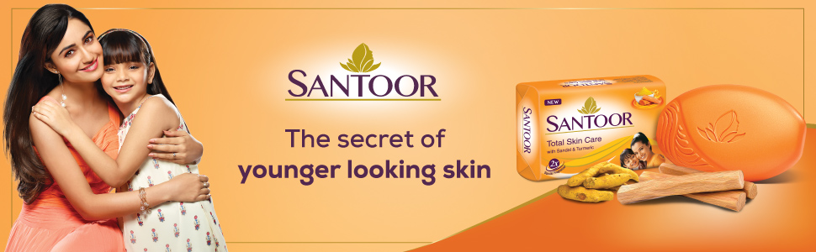
Brand logo

Slide 3
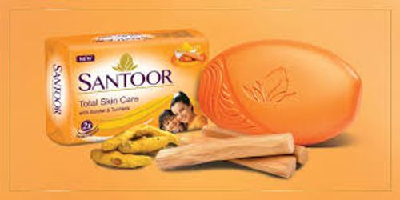
Introduction
Santoor is a leading beauty soap brand from Wipro Consumer Care & Lighting.
Launched in 1986 in India.
Known for its natural ingredients like sandalwood and turmeric.
Tagline: 'Stay Young, Stay Beautiful’.
Target: Women seeking youthful, glowing skin.
Product Range: Soaps, hand wash, talcum powder and body lotion.

Slide 4
Brand Positioning
Positioning: 'For the woman who looks younger than she really is’.
Key Differentiator: Combines traditional ingredients with modern skincare.
Emotional Appeal: Youthful appearance and self-confidence.
Competitors: Lux, Dove, Pears, Godrej No.1, Lifebuoy.

Slide 5
Marketing Strategy – 4 Ps
Product:
Natural ingredients (Sandalwood & Turmeric).
Extended range: lotions, handwash.
Price:
Affordable, competitive pricing.
Place:
Wide distribution (urban + rural).
Available offline & online.
Promotion:
Iconic 'Mistaken Identity' ads.
Traditional + Digital media.

Slide 6
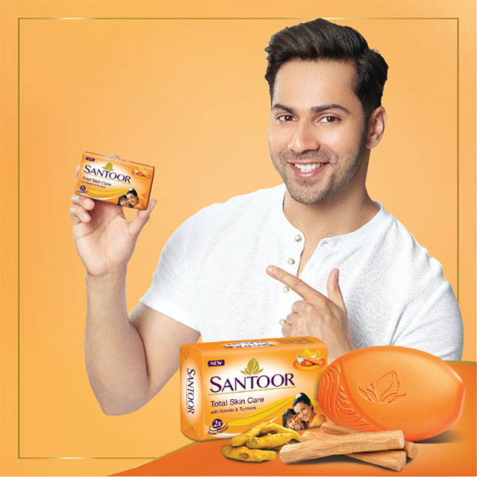
Advertising & Branding
TV Campaigns with emotional storytelling.
Active on YouTube, Instagram, Facebook.
Influencer collaborations and short reels.
Strong brand recall for over 30 years.
https://youtu.be/a1lWGPmInak
https://youtu.be/nC3dWK2vDZc

Slide 7
Market Performance
Among the top 3 soap brands in India.
Market Share: 8–10% in beauty soap segment.
Strong in rural and semi-urban markets.
Available in over 20 countries worldwide.

Slide 8
Future Focus & Strategy
Launching herbal & organic skincare lines.
Strengthening digital & e-commerce presence.
Eco-friendly packaging initiatives.
Targeting Gen Z and tier-2/3 cities.
Focus on skincare education and influencer marketing.

Slide 9
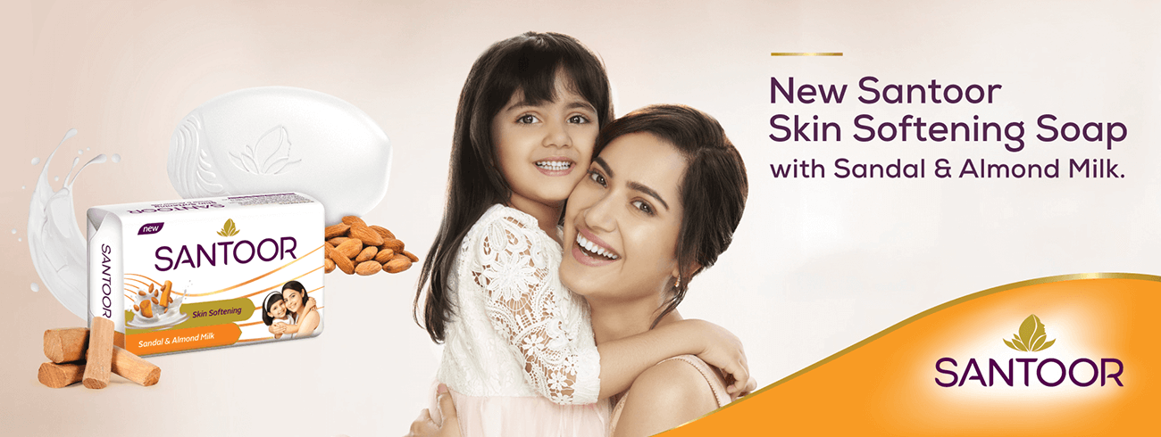
Challenges
Competition from global premium brands (Dove, Nivea).
Rising demand for organic, chemical-free products.
Need to stay relevant to younger consumers

Slide 10

Conclusion
Santoor’s success = consistency, emotion, and affordability.
Blends traditional values with modern appeal.
Future growth via innovation & sustainability.
Santoor remains a trusted symbol of beauty in India.

Slide 11
Thank you

